Slide 1

Data science steps

Slide 2
Objectives
Import datasets
Data wrangling
Exploratory data analysis
Model development
Model evaluation and refinement
Data science steps

Slide 3
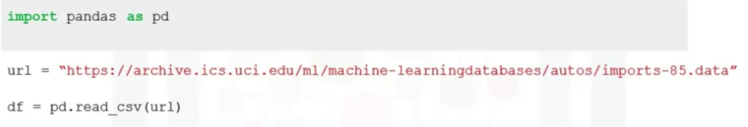
Importing data
Process of loading and reading data into Python from various resource
Two important properties:
  Format: .csv, .json, .xlsx, .hdf,….
  File path of dataset
    Local computer: / d:/mydata.csv
    Internet: http://
Importing a csv into Python:
Data science steps

Slide 4
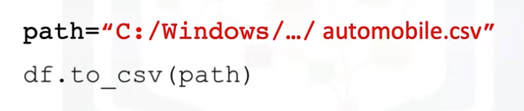
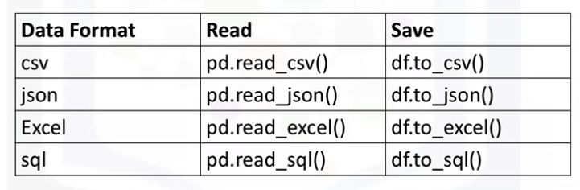
Exporting data
Exporting a Pandas dataframe to CSV
Exporting to different format in Python
Data science steps

Slide 5
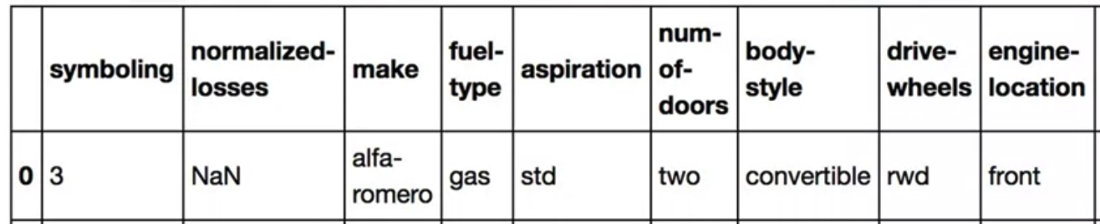
Missing values
Missing values occur when no data value is stored for a variable in an observation
Could be presented as “?”, “N/A”, blank cell
Data science steps

Slide 6
How to deal with missing data
Drop the missing values
  Drop the variable
  Drop the data entry
Replace the missing values
  Replace it with an average
  Replace it by frequency
  Replace it based on other functions
Leave it as missing data
Data science steps

Slide 7
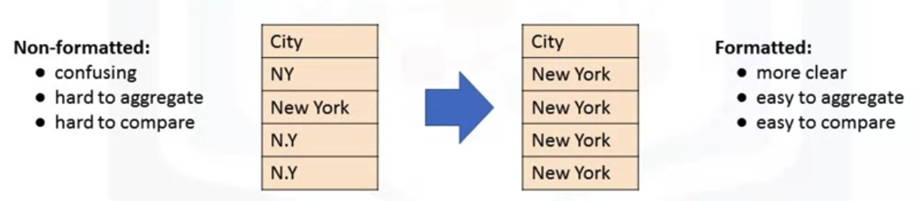
Data formatting
Data are usually collected from difference places and stored in different formats
Bringing data into a common standard of expression allows user to make meaningful comparison
Data science steps

Slide 8
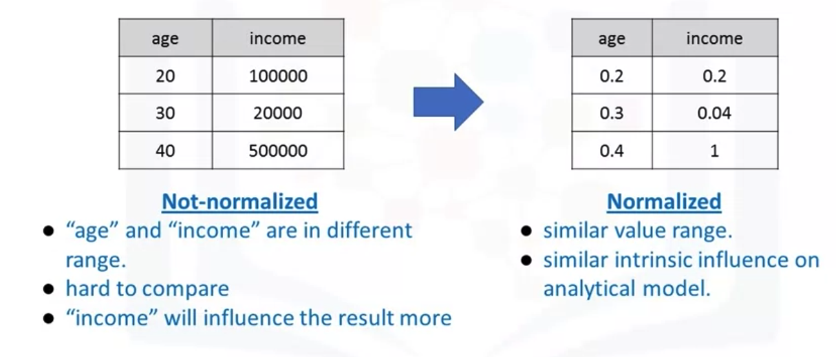
Data Normalization
Uniform the features value with different range
Data science steps

Slide 9
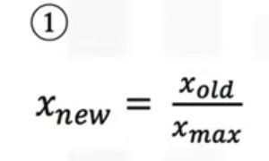
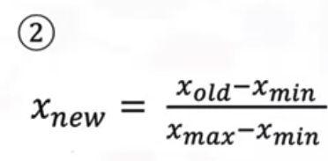
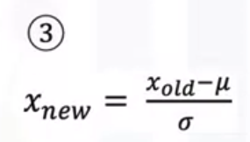
Data Normalization
Several approaches:
  Simple Feature scaling
  Min- Max
  Z- Score
Data science steps

Slide 10
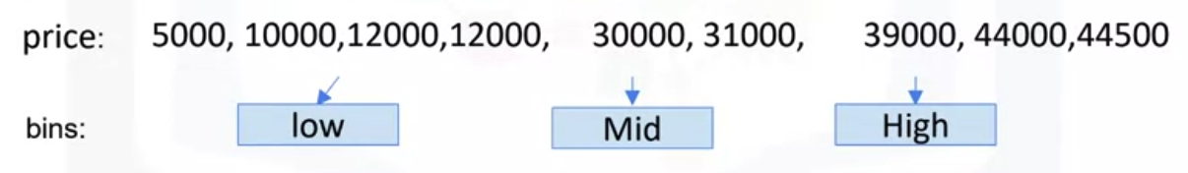
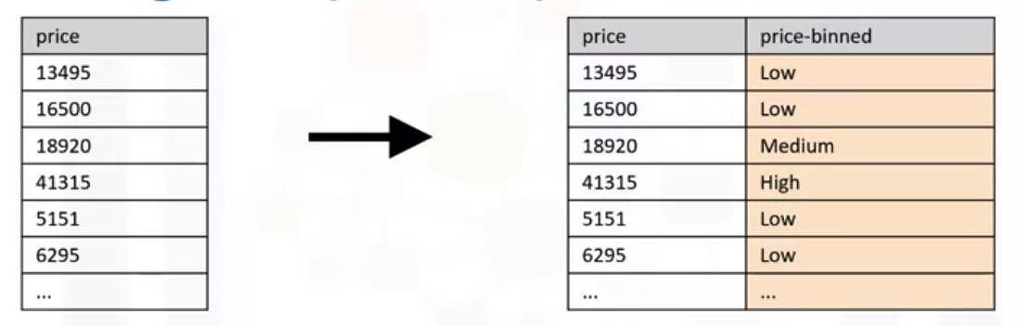
Binning in Python
Binning: grouping of values into “bins”
Converts numeric into categorical variables
Group a set of numerical values into a set of “bins”
Data science steps

Slide 11
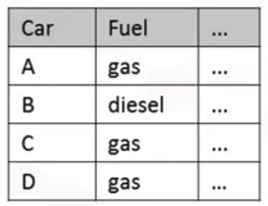
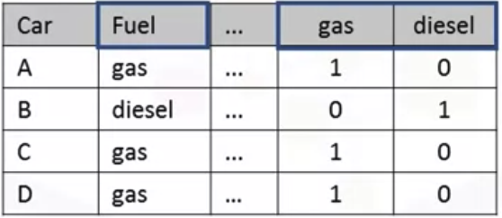
Categorical variables
Problem: most statistical models cannot take in the objects/ string as input
Solution:
  Add dummy variables for each unique category
  Assign 0 or 1 in each category
Data science steps

Slide 12
Summary
Understand import datasets
Understand data wrangling
Understand exploratory data analysis
Understand model development
Understand model evaluation and refinement
Data science steps

Slide 13
Q & A
Data science steps

